Slide 1

JAVA Tutoring Website
IT 331 Project Presentation

Slide 2

Name and URL
Palak Patel
http://mason.gmu.edu/~ppatel19/Project4/home.html

Slide 3
Introduction
The purpose of JAVA Tutoring website is tutoring kids the basics of JAVA Programming Language.
The website will help kids get familiar with the most common programming language.
The website includes links in the navigation like join our group, resources, and contact us.

Slide 4
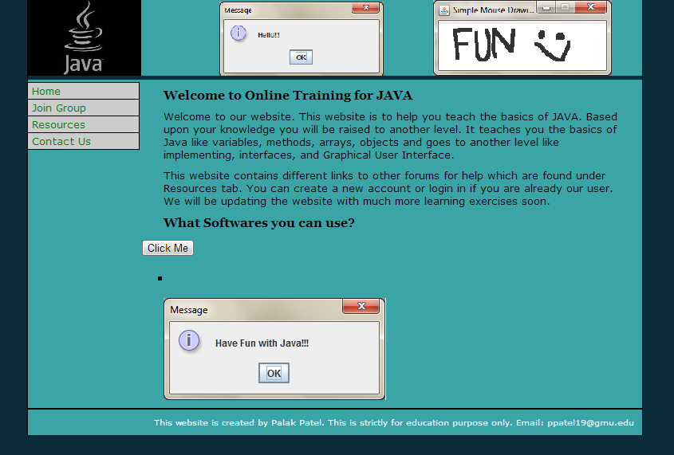
Screenshot – Home Page

Slide 5
Home Page
The Home Page contains:
Link to CSS style sheet
The introduction to the website
The “Click Me” button that uses jQuery Library which gets the data from ‘txt’ file.

Slide 6
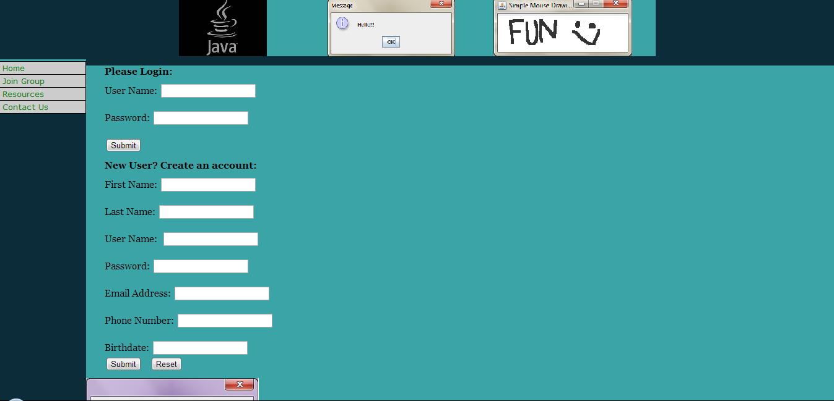
Screenshot – Join Group Page

Slide 7
Join Group Page
The Join Group Page includes:
Link to CSS style sheet
Form Layout
User can log in if they already have an account
User can create an account if they need to
Random image generator
Form validation for three different fields in the form

Slide 8
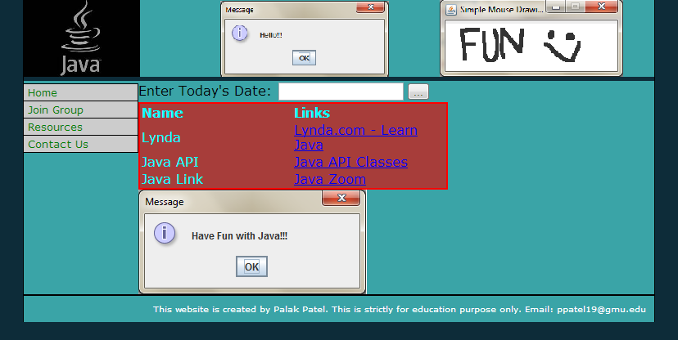
Screenshot – Resources Page

Slide 9
Resources Page
The Resources Page includes:
Link to CSS style sheet
Table that includes external links to JAVA resources
Rollover image that increases in size when it is hovered upon
Datepicker which asks the user to pick a date which uses jQuery Library

Slide 10
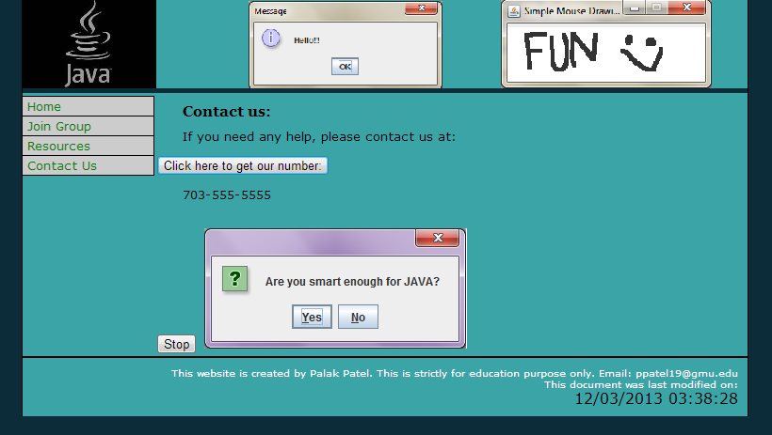
Screenshot – Contact Page

Slide 11
Contact Page
The Contact Page includes:
Link to CSS style sheet
Random Image generator that changes image every second and stops when the stop button is clicked
Includes a number to call if customers need to contact us using contact.xml file

Slide 12
Contact.xml
This file includes:
A number that user can reach us at which is fetched by contact.html file
Displayed it on contact.html webpage when the “Click here to get our number” button

Slide 13
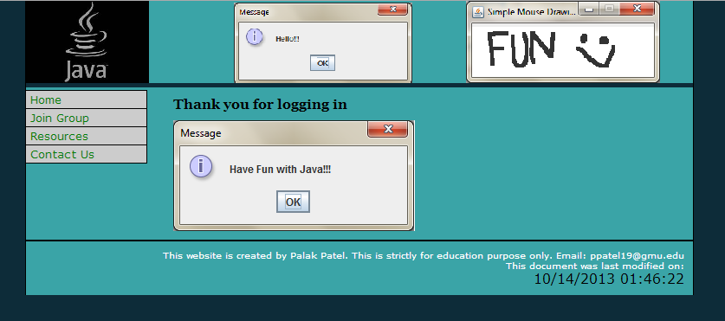
Screenshot – Login Page

Slide 14
Login Page
This page opens only when user logs in successfully from Join page
Includes a JavaScript function to show the last modified date and time on the footer of the page.

Slide 15
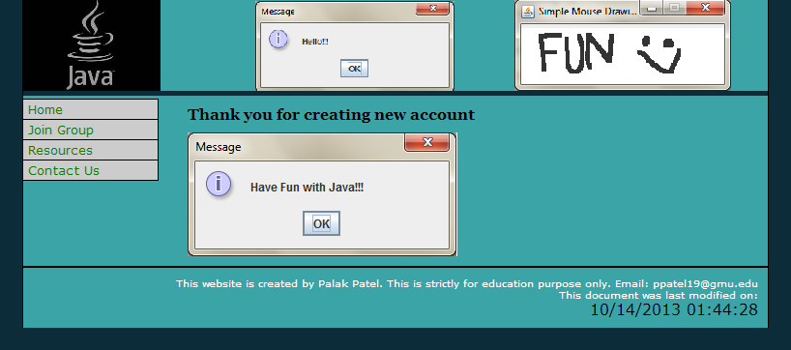
Screenshot – New Account Page

Slide 16
New Account Page
This page only opens when the user creates a new account successfully.
Includes a JavaScript function to show the last modified date and time on the footer of the page.

